Slide 1
Bloom-Filter-Trie Anuved verma

Slide 2
Project
Implemented a data-structure/algorithm I found that looked interesting
“Bloom Filter Trie: an alignment-free and reference-free data structure for pan-genome storage”
Published in “Algorithms for Molecular Biology” earlier this year
Holley G, Wittler R, Stoye J. Bloom Filter Trie: an alignment-free and reference-free data structure for pan-genome storage. Algorithms Mol Biol. 2016;11:3.

Slide 3
Goal
Implement data structure optimized for pan-genome storage and indexing
Holley G, Wittler R, Stoye J. Bloom Filter Trie: an alignment-free and reference-free data structure for pan-genome storage. Algorithms Mol Biol. 2016;11:3.

Slide 4
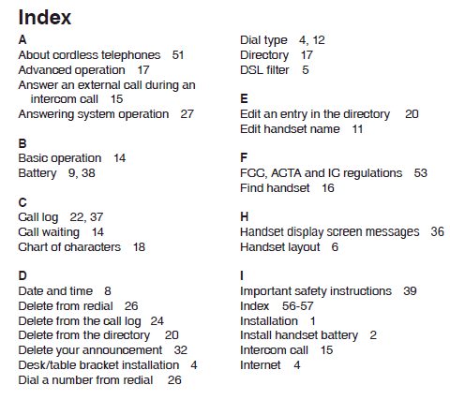
Goal
Implement data structure optimized for pan-genome storage and indexing
Holley G, Wittler R, Stoye J. Bloom Filter Trie: an alignment-free and reference-free data structure for pan-genome storage. Algorithms Mol Biol. 2016;11:3.

Slide 5
Background

Slide 6
Data Structures
Colored De-Bruijn Graph
Bloom Filter
Burst Trie
Uncompressed Container
Compressed Container
Holley G, Wittler R, Stoye J. Bloom Filter Trie: an alignment-free and reference-free data structure for pan-genome storage. Algorithms Mol Biol. 2016;11:3.

Slide 7
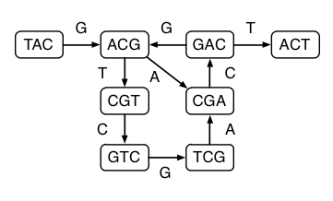
Data Structures: C-DBG
Colored De-Bruijn Graph
K-mers:
TACG
ACGT
CGTC
GTCG
TCGA
CGAC
GACG
……..
Holley G, Wittler R, Stoye J. Bloom Filter Trie: an alignment-free and reference-free data structure for pan-genome storage. Algorithms Mol Biol. 2016;11:3.

Slide 8
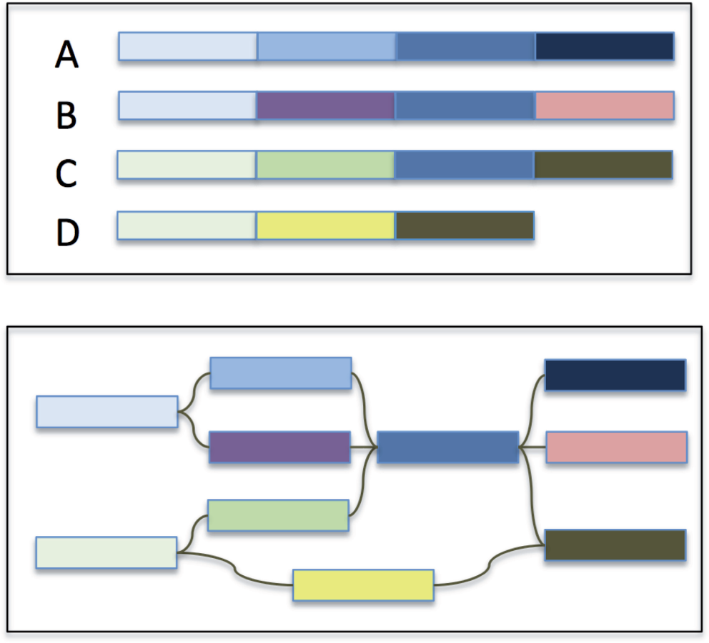
Data Structures: C-DBG
Colored De-Bruijn Graph
Holley G, Wittler R, Stoye J. Bloom Filter Trie: an alignment-free and reference-free data structure for pan-genome storage. Algorithms Mol Biol. 2016;11:3.

Slide 9
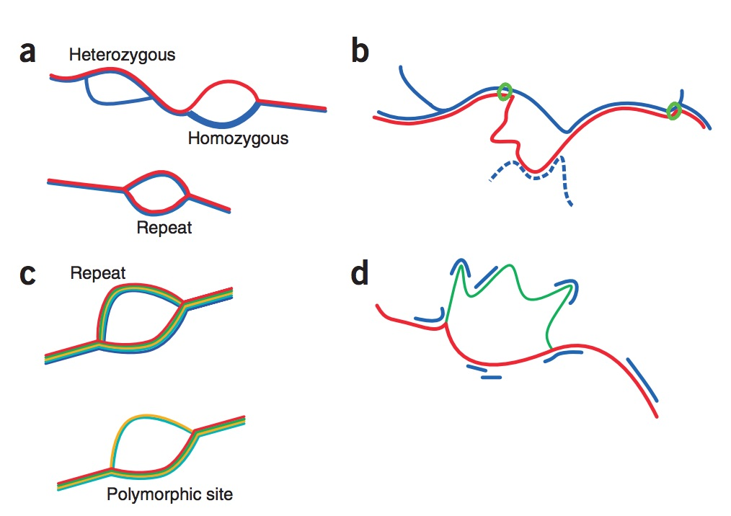
Data Structures: C-DBG
Colored De-Bruijn Graph
Holley G, Wittler R, Stoye J. Bloom Filter Trie: an alignment-free and reference-free data structure for pan-genome storage. Algorithms Mol Biol. 2016;11:3.

Slide 10
Data Structures
Colored De-Bruijn Graph
Bloom Filter
Burst Trie
Uncompressed Container
Compressed Container
Holley G, Wittler R, Stoye J. Bloom Filter Trie: an alignment-free and reference-free data structure for pan-genome storage. Algorithms Mol Biol. 2016;11:3.

Slide 11
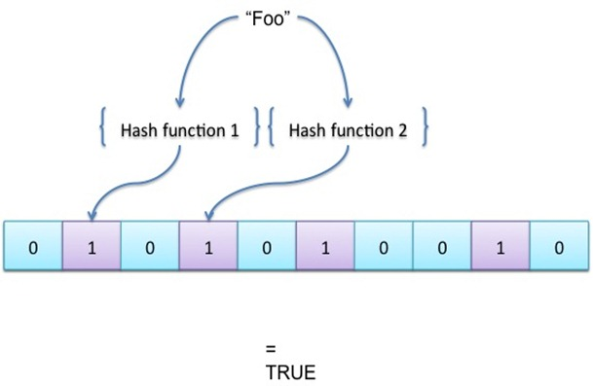
Data Structures: Bloom Filter
Bloom Filter
Holley G, Wittler R, Stoye J. Bloom Filter Trie: an alignment-free and reference-free data structure for pan-genome storage. Algorithms Mol Biol. 2016;11:3.

Slide 12
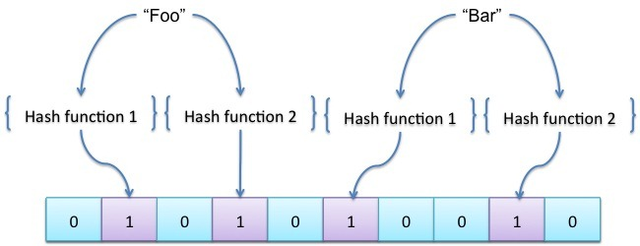
Data Structures: Bloom Filter
Bloom Filter
Holley G, Wittler R, Stoye J. Bloom Filter Trie: an alignment-free and reference-free data structure for pan-genome storage. Algorithms Mol Biol. 2016;11:3.

Slide 13
Data Structures: Bloom Filter
Bloom Filter
O(f) look-up to check input element is a member, where f is the number of hash functions
Holley G, Wittler R, Stoye J. Bloom Filter Trie: an alignment-free and reference-free data structure for pan-genome storage. Algorithms Mol Biol. 2016;11:3.

Slide 14
Data Structures: Bloom Filter
Bloom Filter
O(f) look-up to check input element is a member, where f is the number of hash functions
May result in false-positives, but no false-negatives
Holley G, Wittler R, Stoye J. Bloom Filter Trie: an alignment-free and reference-free data structure for pan-genome storage. Algorithms Mol Biol. 2016;11:3.

Slide 15
Data Structures: Bloom Filter
Bloom Filter
O(f) look-up to check input element is a member, where f is the number of hash functions
May result in false-positives, but no false-negatives
Why not just use a HashMap? BF is constant size!
Holley G, Wittler R, Stoye J. Bloom Filter Trie: an alignment-free and reference-free data structure for pan-genome storage. Algorithms Mol Biol. 2016;11:3.

Slide 16
Data Structures
Colored De-Bruijn Graph
Bloom Filter
Burst Trie
Uncompressed Container
Compressed Container
Holley G, Wittler R, Stoye J. Bloom Filter Trie: an alignment-free and reference-free data structure for pan-genome storage. Algorithms Mol Biol. 2016;11:3.

Slide 17
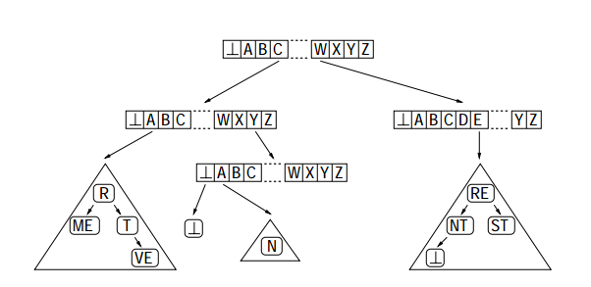
Data Structures: Burst Trie
Burst Trie
Holley G, Wittler R, Stoye J. Bloom Filter Trie: an alignment-free and reference-free data structure for pan-genome storage. Algorithms Mol Biol. 2016;11:3.

Slide 18
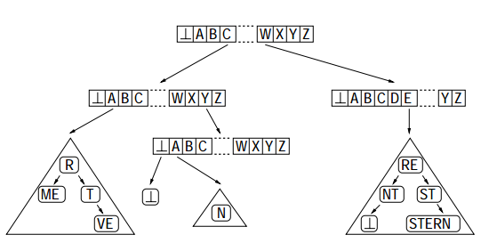
Data Structures: Burst Trie
Burst Trie
Holley G, Wittler R, Stoye J. Bloom Filter Trie: an alignment-free and reference-free data structure for pan-genome storage. Algorithms Mol Biol. 2016;11:3.

Slide 19
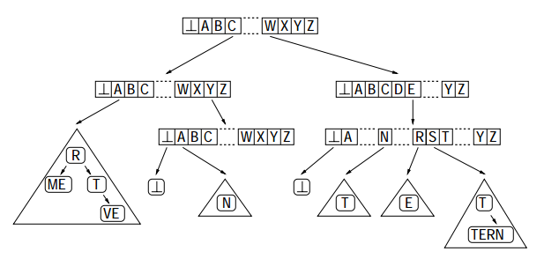
Data Structures: Burst Trie
Burst Trie
Holley G, Wittler R, Stoye J. Bloom Filter Trie: an alignment-free and reference-free data structure for pan-genome storage. Algorithms Mol Biol. 2016;11:3.

Slide 20
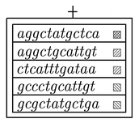
Data Structures: Burst Trie
Burst Trie
Uncompressed Container
Holley G, Wittler R, Stoye J. Bloom Filter Trie: an alignment-free and reference-free data structure for pan-genome storage. Algorithms Mol Biol. 2016;11:3.

Slide 21
Data Structures: Burst Trie
Burst Trie
Uncompressed Container
gcgccaggaatc
Holley G, Wittler R, Stoye J. Bloom Filter Trie: an alignment-free and reference-free data structure for pan-genome storage. Algorithms Mol Biol. 2016;11:3.

Slide 22
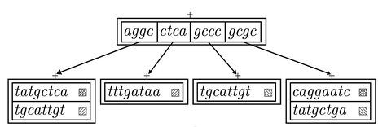
Data Structures: Burst Trie
Burst Trie
Uncompressed Container
Compressed Container
gcgccaggaatc
Holley G, Wittler R, Stoye J. Bloom Filter Trie: an alignment-free and reference-free data structure for pan-genome storage. Algorithms Mol Biol. 2016;11:3.

Slide 23
Data Structures
Colored De-Bruijn Graph
Bloom Filter
Burst Trie
Uncompressed Container
Compressed Container
Holley G, Wittler R, Stoye J. Bloom Filter Trie: an alignment-free and reference-free data structure for pan-genome storage. Algorithms Mol Biol. 2016;11:3.

Slide 24
Bloom Filter Trie
Holley G, Wittler R, Stoye J. Bloom Filter Trie: an alignment-free and reference-free data structure for pan-genome storage. Algorithms Mol Biol. 2016;11:3.

Slide 25
Bloom Filter Trie: Structure
Each vertex has:
at MOST ONE Uncompressed Container
Any number of Compressed Containers
Holley G, Wittler R, Stoye J. Bloom Filter Trie: an alignment-free and reference-free data structure for pan-genome storage. Algorithms Mol Biol. 2016;11:3.

Slide 26
Bloom Filter Trie: Structure
Each vertex has:
at MOST ONE Uncompressed Container
Any number of Compressed Containers
Vertex
Holley G, Wittler R, Stoye J. Bloom Filter Trie: an alignment-free and reference-free data structure for pan-genome storage. Algorithms Mol Biol. 2016;11:3.

Slide 27

Bloom Filter Trie: Structure
Each vertex has:
at MOST ONE Uncompressed Container
Any number of Compressed Containers
Vertex
Holley G, Wittler R, Stoye J. Bloom Filter Trie: an alignment-free and reference-free data structure for pan-genome storage. Algorithms Mol Biol. 2016;11:3.

Slide 28
Bloom Filter Trie: Structure
Each vertex has:
at MOST ONE Uncompressed Container
Any number of Compressed Containers
Vertex
Holley G, Wittler R, Stoye J. Bloom Filter Trie: an alignment-free and reference-free data structure for pan-genome storage. Algorithms Mol Biol. 2016;11:3.

Slide 29
Bloom Filter Trie: Structure
Each vertex has:
at MOST ONE Uncompressed Container
Any number of Compressed Containers
Vertex
Holley G, Wittler R, Stoye J. Bloom Filter Trie: an alignment-free and reference-free data structure for pan-genome storage. Algorithms Mol Biol. 2016;11:3.

Slide 30
Bloom Filter Trie: Structure
Each vertex has:
at MOST ONE Uncompressed Container
Any number of Compressed Containers
Vertex
Holley G, Wittler R, Stoye J. Bloom Filter Trie: an alignment-free and reference-free data structure for pan-genome storage. Algorithms Mol Biol. 2016;11:3.

Slide 31
Bloom Filter Trie: Structure
Each vertex has:
at MOST ONE Uncompressed Container
Any number of Compressed Containers
Vertex
Holley G, Wittler R, Stoye J. Bloom Filter Trie: an alignment-free and reference-free data structure for pan-genome storage. Algorithms Mol Biol. 2016;11:3.

Slide 32
Bloom Filter Trie: Structure
Each vertex has:
at MOST ONE Uncompressed Container
Any number of Compressed Containers
Vertex
Holley G, Wittler R, Stoye J. Bloom Filter Trie: an alignment-free and reference-free data structure for pan-genome storage. Algorithms Mol Biol. 2016;11:3.

Slide 33
Bloom Filter Trie: Structure
Each vertex has:
at MOST ONE Uncompressed Container
Any number of Compressed Containers
Vertex
Holley G, Wittler R, Stoye J. Bloom Filter Trie: an alignment-free and reference-free data structure for pan-genome storage. Algorithms Mol Biol. 2016;11:3.

Slide 34
Bloom Filter Trie: Compression
What happens when we’re compressing a container?
Holley G, Wittler R, Stoye J. Bloom Filter Trie: an alignment-free and reference-free data structure for pan-genome storage. Algorithms Mol Biol. 2016;11:3.

Slide 35
Bloom Filter Trie: Compression
What happens when we’re compressing a container?
Holley G, Wittler R, Stoye J. Bloom Filter Trie: an alignment-free and reference-free data structure for pan-genome storage. Algorithms Mol Biol. 2016;11:3.

Slide 36
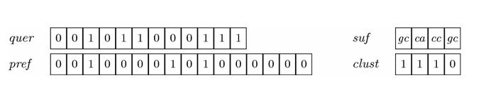
Bloom Filter Trie: Compression
What happens when we’re compressing a container?
Holley G, Wittler R, Stoye J. Bloom Filter Trie: an alignment-free and reference-free data structure for pan-genome storage. Algorithms Mol Biol. 2016;11:3.

Slide 37
Bloom Filter Trie: Compression
What happens when we’re compressing a container?
Compressed container stores the first L letters of the K-mer
Holley G, Wittler R, Stoye J. Bloom Filter Trie: an alignment-free and reference-free data structure for pan-genome storage. Algorithms Mol Biol. 2016;11:3.

Slide 38
Bloom Filter Trie: Compression
What happens when we’re compressing a container?
Compressed container stores the first L letters of the K-mer
quer : bloom filter
pref : stores first a letters of L
suf : stores last b letters of L (where L = a + b)
clust : stores “cluster start postitions”
Holley G, Wittler R, Stoye J. Bloom Filter Trie: an alignment-free and reference-free data structure for pan-genome storage. Algorithms Mol Biol. 2016;11:3.

Slide 39
Bloom Filter Trie: Compression
quer : bloom filter
pref : stores first a letters of L
suf : stores last b letters of L (where L = a + b)
clust : stores “cluster start postitions”
Holley G, Wittler R, Stoye J. Bloom Filter Trie: an alignment-free and reference-free data structure for pan-genome storage. Algorithms Mol Biol. 2016;11:3.

Slide 40
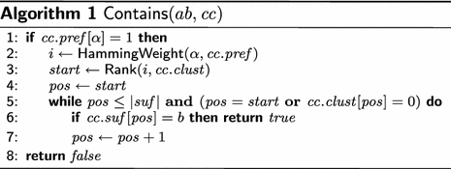
Bloom Filter Trie: Algorithms
Look-up is O(|pref| + |q|)
Holley G, Wittler R, Stoye J. Bloom Filter Trie: an alignment-free and reference-free data structure for pan-genome storage. Algorithms Mol Biol. 2016;11:3.

Slide 41
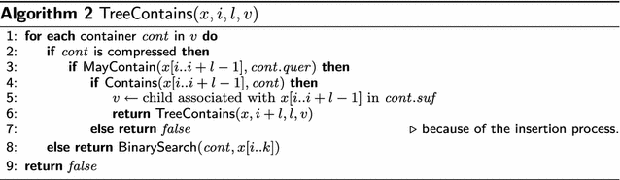
Bloom Filter Trie: Algorithms
Longest path of a BFT has K / L vertices
Holley G, Wittler R, Stoye J. Bloom Filter Trie: an alignment-free and reference-free data structure for pan-genome storage. Algorithms Mol Biol. 2016;11:3.

Slide 42

Bloom Filter Trie: Algorithms
Insertion:
Holley G, Wittler R, Stoye J. Bloom Filter Trie: an alignment-free and reference-free data structure for pan-genome storage. Algorithms Mol Biol. 2016;11:3.

Slide 43
Bloom Filter Trie: Algorithms
Insertion:
If Uncompressed Container: just put it in alphabetically: O(lg n)
Holley G, Wittler R, Stoye J. Bloom Filter Trie: an alignment-free and reference-free data structure for pan-genome storage. Algorithms Mol Biol. 2016;11:3.

Slide 44
Bloom Filter Trie: Algorithms
Insertion:
If Uncompressed Container: just put it in alphabetically: O(lg n)
If Compressed Container…
Holley G, Wittler R, Stoye J. Bloom Filter Trie: an alignment-free and reference-free data structure for pan-genome storage. Algorithms Mol Biol. 2016;11:3.

Slide 45
Bloom Filter Trie: Algorithms
Insertion:
If Uncompressed Container: just put it in alphabetically: O(lg n)
If Compressed Container…
1) Calculate cluster start point with HammingWeight
Holley G, Wittler R, Stoye J. Bloom Filter Trie: an alignment-free and reference-free data structure for pan-genome storage. Algorithms Mol Biol. 2016;11:3.

Slide 46
Bloom Filter Trie: Algorithms
Insertion:
If Uncompressed Container: just put it in alphabetically: O(lg n)
If Compressed Container…
1) Calculate cluster start point with HammingWeight
2) Iterate through suf and insert alphabetically
Holley G, Wittler R, Stoye J. Bloom Filter Trie: an alignment-free and reference-free data structure for pan-genome storage. Algorithms Mol Biol. 2016;11:3.

Slide 47

Bloom Filter Trie: Algorithms
Insertion:
If Uncompressed Container: just put it in alphabetically: O(lg n)
If Compressed Container…
1) Calculate cluster start point with HammingWeight
2) Iterate through suf and insert alphabetically
Holley G, Wittler R, Stoye J. Bloom Filter Trie: an alignment-free and reference-free data structure for pan-genome storage. Algorithms Mol Biol. 2016;11:3.

Slide 48
My Results
Individual components work great, but…
Holley G, Wittler R, Stoye J. Bloom Filter Trie: an alignment-free and reference-free data structure for pan-genome storage. Algorithms Mol Biol. 2016;11:3.

Slide 49
My Results
Individual components work great, but…
OutOfHeapMemory error, even when inserting TINY sequences (30bp sequences with K-mers of size 10)
Holley G, Wittler R, Stoye J. Bloom Filter Trie: an alignment-free and reference-free data structure for pan-genome storage. Algorithms Mol Biol. 2016;11:3.

Slide 50
My Results
Individual components work great, but…
OutOfHeapMemory error, even when inserting TINY sequences (30bp sequences with K-mers of size 10)
My implementation turned out to be significantly more memory-expensive than what the paper promised
Holley G, Wittler R, Stoye J. Bloom Filter Trie: an alignment-free and reference-free data structure for pan-genome storage. Algorithms Mol Biol. 2016;11:3.

Slide 51
Questions?

